Slide 1


What does international climate law require from states on the path to net zero?
Corina Heri
Associate Professor of Human Rights and Climate Change at Vrije Universiteit Brussel

Slide 2
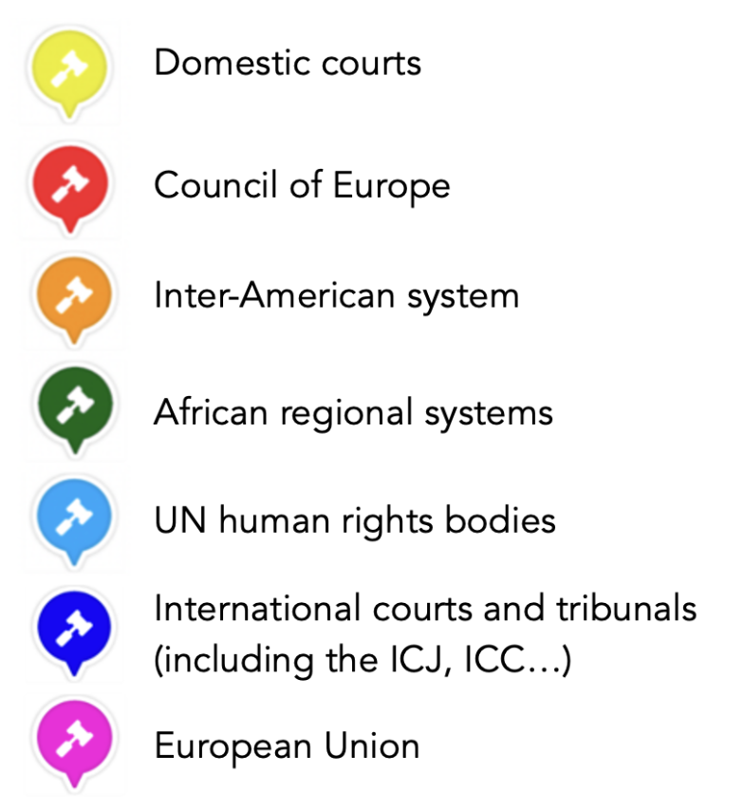
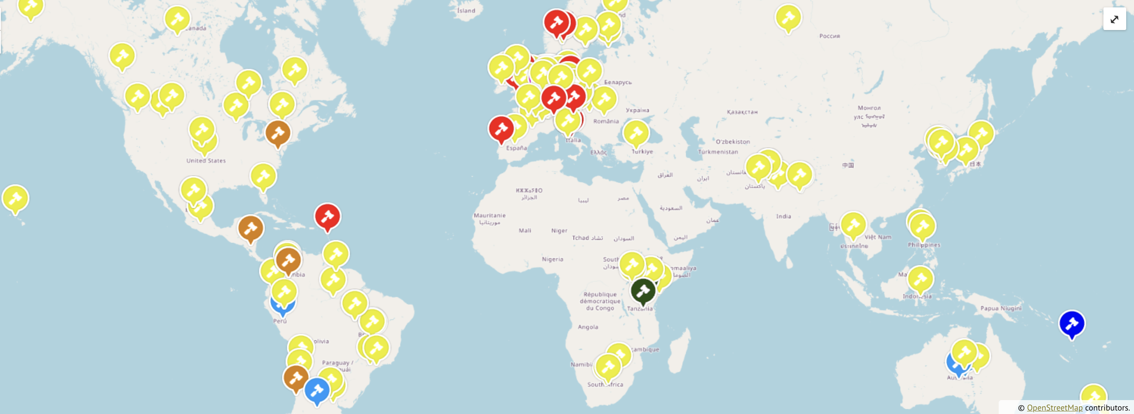
The ongoing ‘turn to rights’ in climate litigation

Slide 3
Overarching themes
Binding international legal obligations
Legal baselines (minimum standards), coupled with deference to domestic decision-makers
Obligation on domestic policy-makers to flesh out the framework created by international law
Obligation to regulate, protect and act with due diligence to comply with 1,5-degree target
Harmonization (of customary international law, international human rights law, environmental law principles, international climate treaties), not displacement
Obligations to take immediate and long-term action

Slide 4
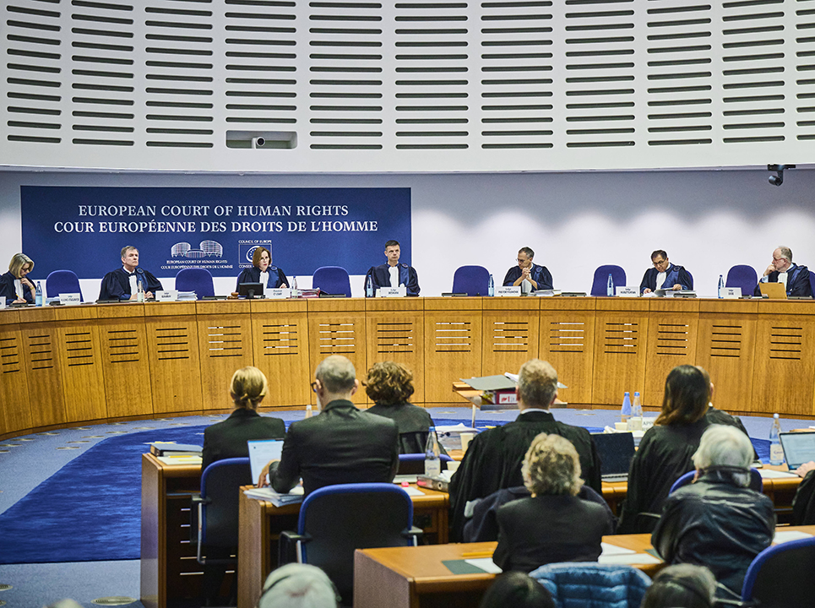
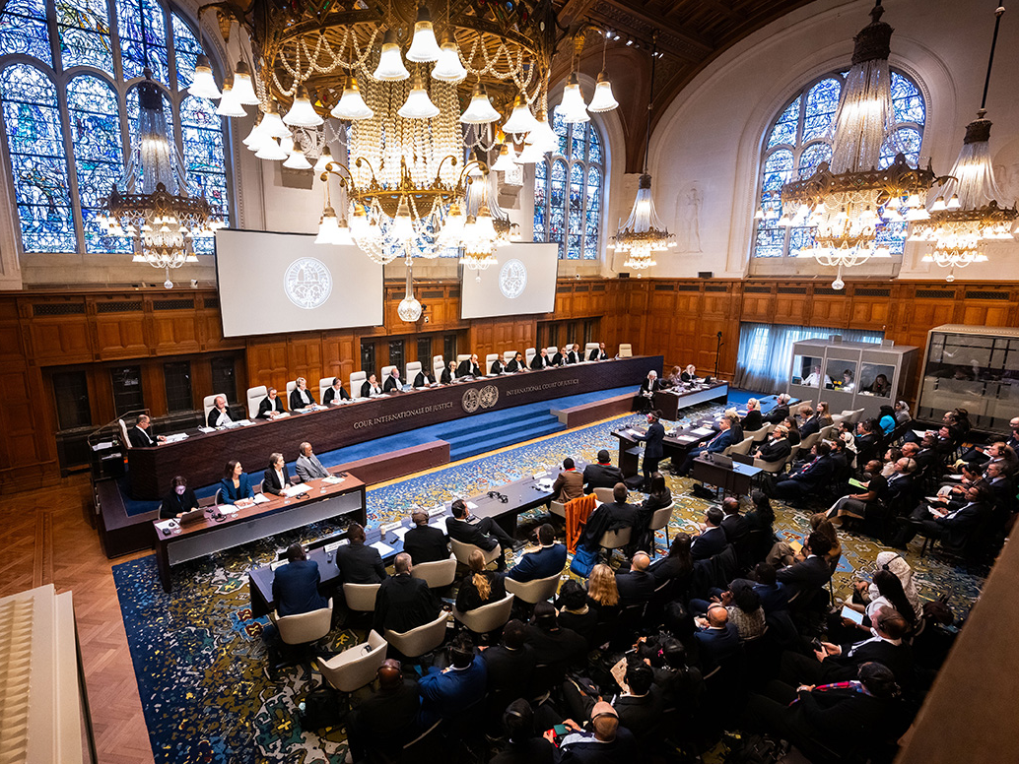
Two key international judicial findings
ECtHR, KlimaSeniorinnen v. Switzerland (2024)
International Court of Justice,
Climate Advisory Opinion (2025)
First international violation judgment in a mitigation case
98 states and 13 international organizations
(not including Belgium)

Slide 5
What does international law require?
(Paris Agreement, ECtHR, ICJ)
Cooperation: (Customary) duty to co-operate for the protection of the environment and repair harm
Mitigation: Obligation on States to act with due diligence and do their utmost to mitigate climate change, including through action on fossil fuel production and consumption
Adaptation: Binding obligation to create a national adaptation plan
Procedure: Access to court, access to a remedy, obligation to carry out environmental/climate impact assessments
Alignment with 1.5°C
Binding obligations of result
(e.g. Nationally Determined Contribution)
Binding obligations of conduct (require parties to use their best efforts to achieve mitigation)
Setting of interim targets and creation of adequate regulatory frameworks; periodic updating in light of best available science

Slide 6
The timing of mitigation action
Combination of immediate and long-term action: duties extending beyond 2030
Immediate action
ECtHR: “to avoid a disproportionate burden on future generations, immediate action needs to be taken and adequate intermediate reduction goals must be set for the period leading to net neutrality” (para. 549)
ICJ: Achieving the 1,5-degree temperature goal, “as well as the aim to reach a global peaking of GHG emissions as soon as possible, are obligations addressed to all parties as a whole” (para. 231)
Long-term action
ECtHR: Under Article 8 ECHR, each State must “undertake measures for the substantial and progressive reduction of their respective GHG emission levels, with a view to reaching net neutrality within, in principle, the next three decades” (para. 548)
ICJ: Obligation to “reach a global peaking of greenhouse gas emissions as soon as possible” (para. 230); “NDCs must become more demanding over time” (progression principle, para. 241)

Slide 7
A domestic margin of appreciation coupled with international oversight
When assessing whether a State has remained within its margin of appreciation, the Court will examine whether the competent domestic authorities, be it at the legislative, executive or judicial level, have had due regard to the need to:
(a) adopt general measures specifying a target timeline for achieving carbon neutrality and the overall remaining carbon budget (…);
(b) set out intermediate GHG emissions reduction targets and pathways (…);
(c) provide evidence showing whether they have duly complied (…) with the relevant GHG reduction targets;
(d) keep the relevant GHG reduction targets updated with due diligence, and based on the best available evidence; and
(e) act in good time and in an appropriate and consistent manner when devising and implementing the relevant legislation and measures.
ECtHR in KlimaSeniorinnen (para. 550)

Slide 8
Rebutting common misunderstandings:
The view from international courts
“Our share is too small to matter”
Clear consensus from international courts: contribution, not sole causation, is the legal standard (no “but for” causation); every ton of CO₂ contributes to climate change
“We still have time to act”
Argument of Swiss courts in KlimaSeniorinnen – was clearly rejected based on science, urgency of action and own climate policy, also violation of Art. 6 ECHR (right of access to court)
“The legal obligations are not clear”
Clear international legal consensus that States have obligations to mitigate, adapt and repair/cooperate
NDCs must “be capable of making an adequate contribution to the achievement of the temperature goal”
“We should talk about corporate actors, not states”
States have obligations to regulate corporate actors, evaluate climate impacts of projects, including ‘scope 3’/ combustion emissions of fossil fuel projects (ECtHR, Greenpeace Nordic)
In parallel: legal responsibility of ‘carbon majors’ is crystallizing – Milieudefensie, RWE, TotalEnergies, Holcim and Falys cases.
“This is a political issue, not a legal one”
As impacts legal obligations (e.g. human rights), courts all confirm: this is inherently a legal issue

Slide 9
The legal baseline for climate action
International law requires States to act on climate change through a converging tapestry of obligations – including treaties (ECHR, Paris Agreement) and customary law (ICJ)
Domestic law can go above this baseline, but not below it
Regional and international courts willing to engage with cases where domestic courts and legislatures don’t act
Obligations are continually being refined: e.g. ECtHR Müllner case, UN Human Rights Committee’s Poelina v. Australia, with no sign of slowing

Slide 10
Thank you for your attention!
corina.heri@vub.be

